Slide 1
Investment Returns
By Syeda Ayesha Gillani

Slide 2
Introduction to Financial Analysis:
The trends of investment returns have been notably changing.

Slide 3
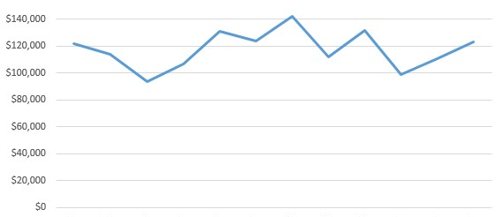
This line chart shows the financial trends.
The data has been recorded for a year, and the investment returns show above changes.

Slide 4
Suggestions:
Company should invest more wisely.
The expenditure must be minimalized so more profit can be earned.

